Slide 1

3BEES&ME
Bert V. M.
Bram V.
Brend L.
Mattijs S.
HOWESTSTONE

Slide 2
3BEES&ME
HARDEST CODE

Slide 3
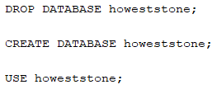
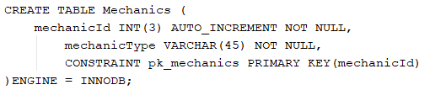
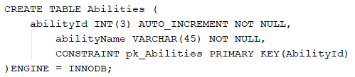
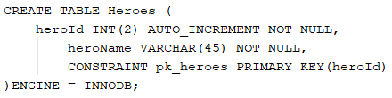
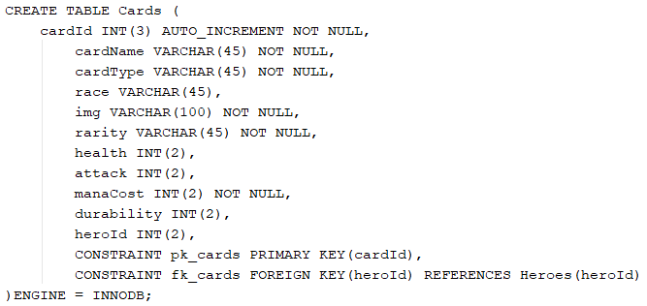
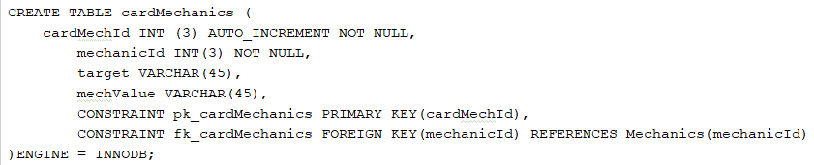
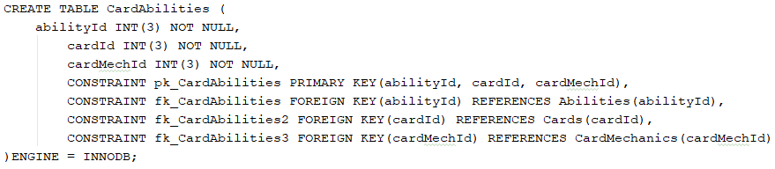
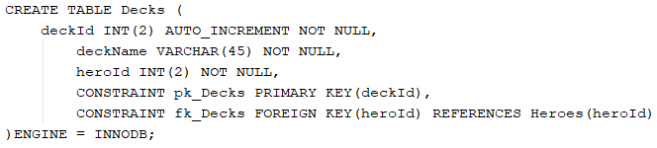
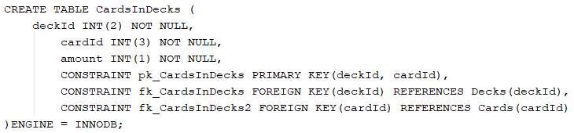

3BEES&ME
HARDEST CODE
BRAM
‘s hardest code was

Slide 4
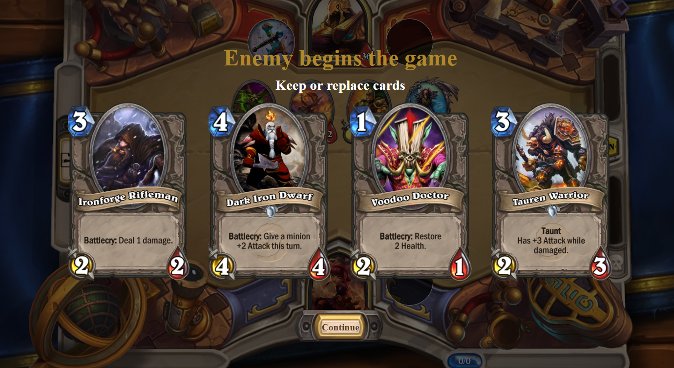
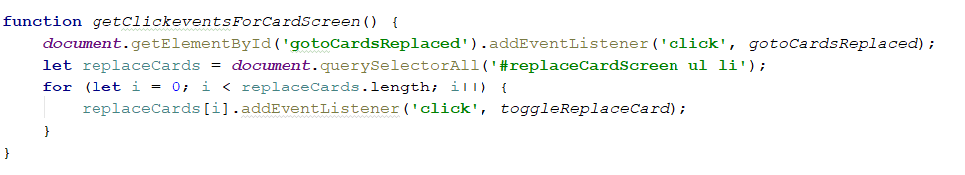
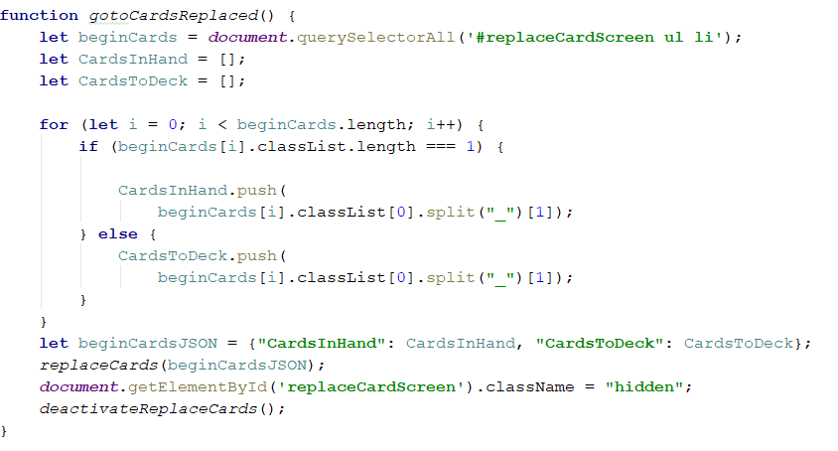
3BEES&ME
BERT
‘s hardest code was

Slide 5
3BEES&ME
BREND
‘s hardest code was

Slide 6
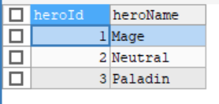
3BEES&ME
MATTIJS
‘s hardest code was

Slide 7
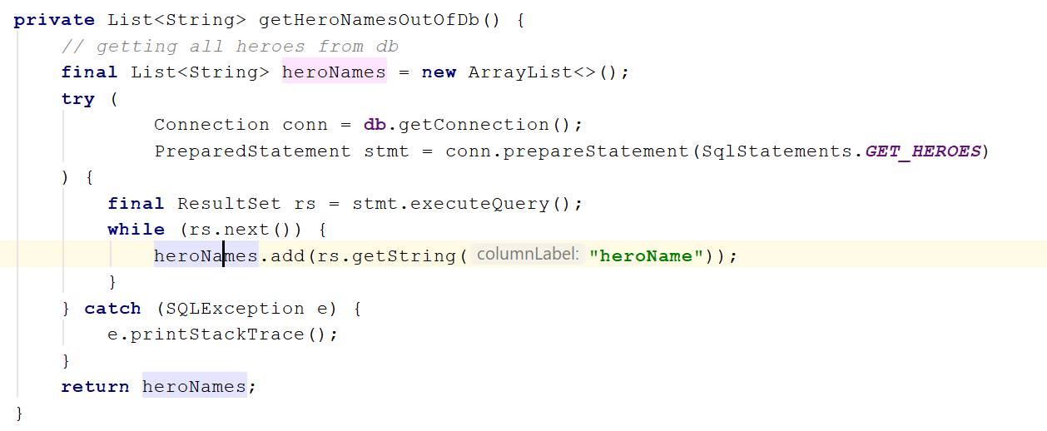
3BEES&ME
MATTIJS
‘s hardest code was

Slide 8
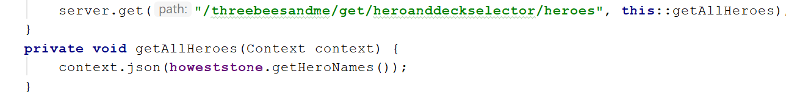
3BEES&ME
MATTIJS
‘s hardest code was

Slide 9
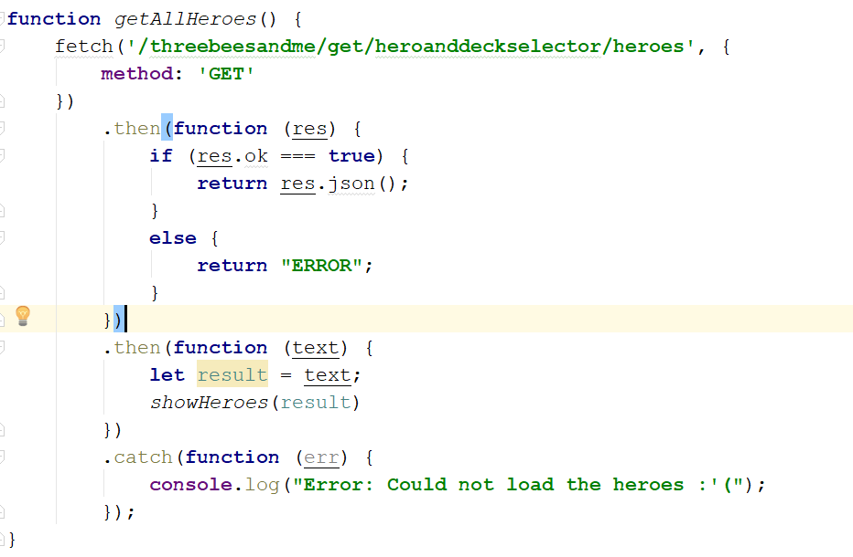
3BEES&ME
MATTIJS
‘s hardest code was

Slide 10
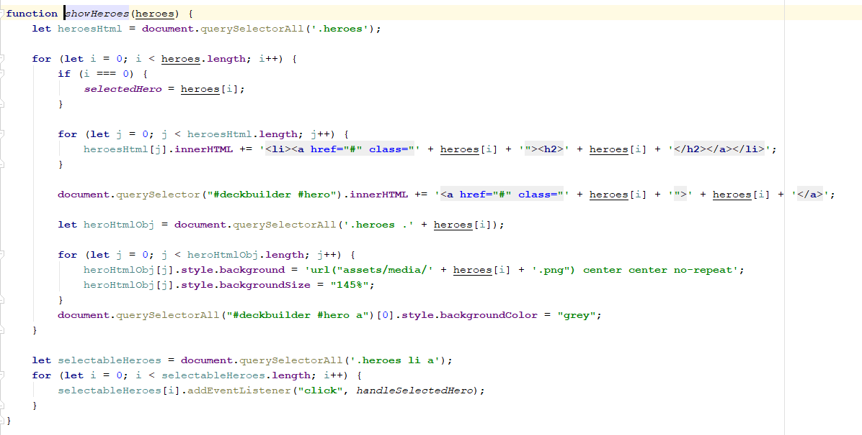
3BEES&ME
MATTIJS
‘s hardest code was

Slide 11
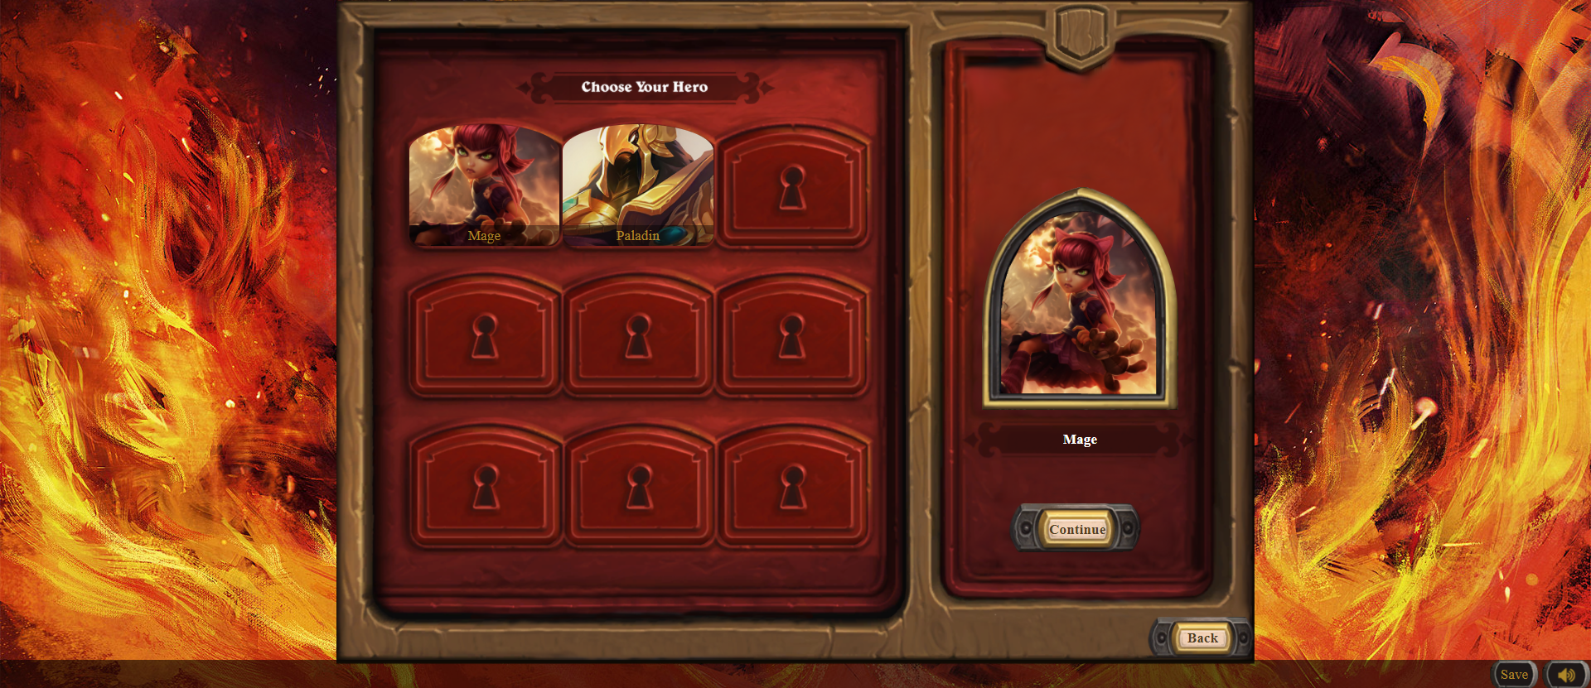
3BEES&ME
MATTIJS
‘s hardest code was

Slide 12
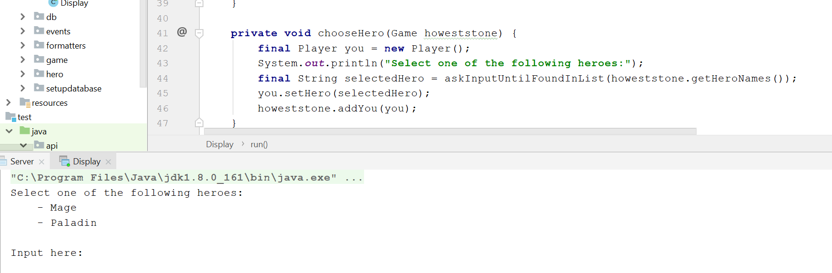
3BEES&ME
MATTIJS
‘s hardest code was

Slide 13
3BEES&ME
WE ARE PROUD

Slide 14
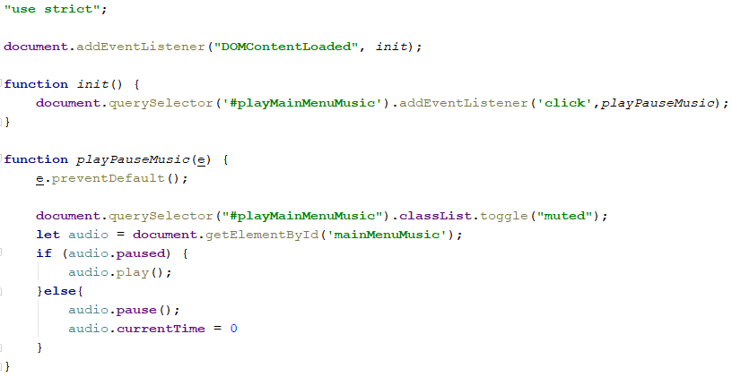
3BEES&ME
BRAM
is proud of
his coach Badlapje

Slide 15
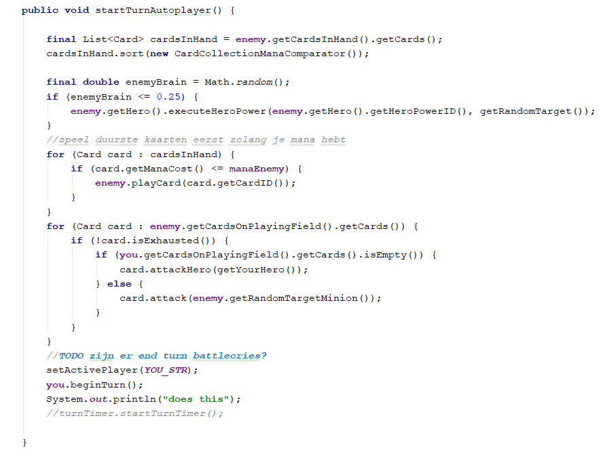
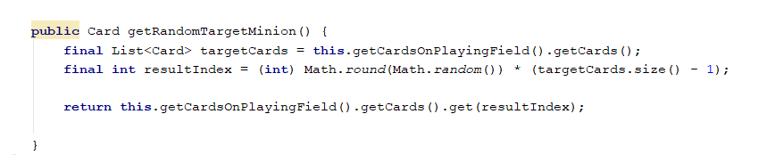
3BEES&ME
BERT
is proud of
his coach Badlapje

Slide 16
3BEES&ME
BREND
is proud of
his coach Badlapje

Slide 17
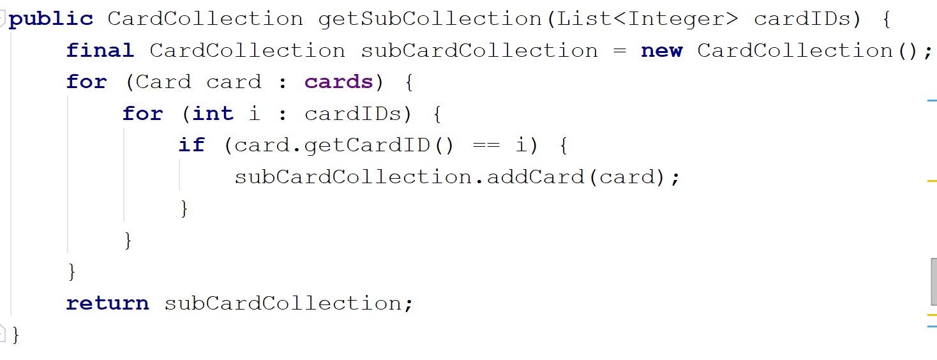
3BEES&ME
MATTIJS
is proud of
his coach Badlapje

